Slide 1
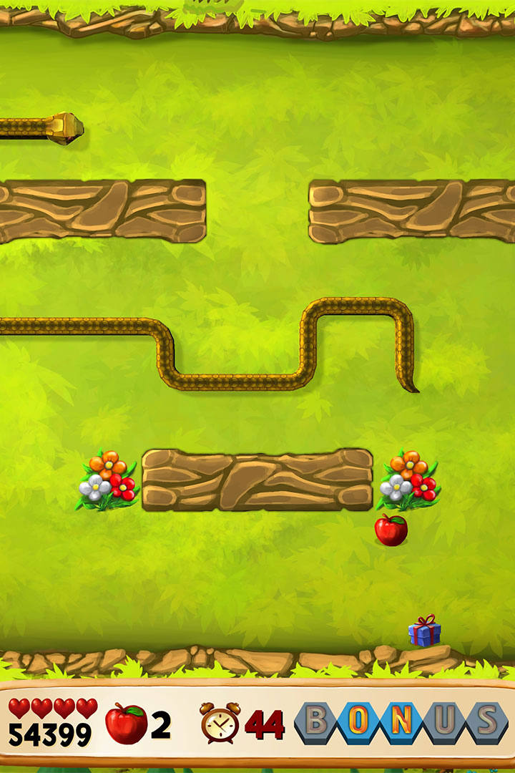

Snake Game Web Application: A Journey of Fun and Learning
Welcome to the world of the Snake Game Web Application! Explore the exciting features and functionalities that make it a fun and educational experience for all.

Slide 2
Introduction: Dive into the Snake Game Universe
1
Classic Retro Game
2
Enhanced Gameplay
Experience the nostalgia of the original Snake Game, loved by millions since its inception.
Discover modern twists with customizable themes, power-ups, and challenging levels.
3
Accessible on All Devices
4
Engaging Learning Tool
Enjoy the game on various platforms, including desktops, tablets, and smartphones.
Unleash your creativity and problem-solving skills through game development and programming concepts.

Slide 3
Working: The Mechanics Behind the Slithering Adventure
Player Controls
Food Collection
Obstacle Avoidance
Guide the snake by using arrow keys or swiping gestures on touch-enabled devices.
Eat the food (represented by dots) to grow longer and gain points.
Avoid collisions with the snake's own body or obstacles within the game area.

Slide 4

Uses: Fun and Educational Applications
Recreation and Entertainment
Enjoy leisure time with family and friends, challenging each other for the highest score.
Stress Relief
Escape from daily pressures as you immerse yourself in a captivating and relaxing gaming experience.
Teaching Programming
Use the Snake Game as an engaging tool to introduce coding concepts and logical thinking.

Slide 5

Advantages & Disadvantages: Weighing the Scales of the Snake Game
1
Advantages
2
Disadvantages
Enhances hand-eye coordination, concentration, and strategic thinking skills.
Possible addiction and distraction if played excessively or in inappropriate settings.

Slide 6

Future Scope: Expanding the Snake Game Universe
1
Multiplayer Mode
Challenge friends online and compete for the highest rank on the global leaderboard.
2
Innovative Power-ups
Introduce exciting power-ups like time freeze, speed boost, and teleportation.
3
Advanced Graphics and Animations
Elevate visual appeal with stunning artwork, captivating animations, and immersive effects.

